Slide 1
Data Warehouses and OLAP
*Slides by Nikos Mamoulis

Slide 2
Data Warehousing and OLAP Technology for Data Mining
What is a data warehouse?
A multi-dimensional data model
Data warehouse architecture
Data warehouse implementation
Further development of data cube technology
From data warehousing to data mining

Slide 3
Why Data Warehousing?
Data warehousing can be considered as an important preprocessing step for data mining
A data warehouse also provides on-line analytical processing (OLAP) tools for interactive multidimensional data analysis.
Heterogeneous
Databases
data selection
Data Warehouse
data cleaning
data integration
data summarization

Slide 4
Example of a Data Warehouse (1)
US-Database
Data Warehouse
Employee
Department
FACT table
eid | name | birthdate
... | ... | ...
did | dname
... | ...
timeid | pid | sales
1 | 1 | 2
2 | 1 | 4
2 | 2 | 1
3 | 3 | 2
... | ... | ...
Transaction
Details
tid | type | date
1 | sale | 4/11/1999
2 | sale | 5/2/1999
3 | buy | 5/17/1999
... | ... | ...
tid | pid | qty
1 | 21 | 2
2 | 13 | 1
3 | 41 | 3
... | ... | ...
dimension 1: time
timeid | day | month | year
1 | 11 | 4 | 1999
2 | 15 | 4 | 1999
3 | 2 | 5 | 1999
... | ... |  | ...
HK-Database
Supplier
Country
sid | name | birthdate
... | ... | ...
cid | cname
... | ...
dimension 2: product
sid | date | time | qty | pid
1 | 15:4:1999 | 8:30 | 2 | 11
2 | 15:4:1999 | 9:30 | 2 | 11
3 | ??? |  | 3 | 56
4 | 19:5:1999 |  | 4 | 22
... | ...
pid | name | type
1 | chair | office
2 | table | office
3 | desk | office
... | ...
Sales

Slide 5
Example of a Data Warehouse (2)
Data Selection
  Only data which are important for analysis are selected (e.g., information about employees, departments, etc. are not stored in the warehouse)
  Therefore the data warehouse is subject-oriented
Data Integration
  Consistency of attribute names
  Consistency of attribute data types. (e.g., dates are converted to a consistent format)
  Consistency of values (e.g., product-ids are converted to correspond to the same products from both sources)
  Integration of data (e.g, data from both sources are integrated into the warehouse)

Slide 6
Example of a Data Warehouse (3)
Data Cleaning
  Tuples which are incomplete or logically inconsistent are cleaned
Data Summarization
  Values are summarized according to the desired level of analysis
  For example, HK database records the daytime a sales transaction takes place, but the most detailed time unit we are interested for analysis is the day.

Slide 7
Example of a Data Warehouse (4)
Example of an OLAP query (collects counts)
  Summarize all company sales according to product and year, and further aggregate on each of these dimensions.
year
1999
2000
2001
2002
ALL
chairs
25 | 37 | 89 | 21 | 172
10 | 30 | 0 | 45 | 85
56 | 84 | 9 | 35 | 184
19 | 20 | 0 | 71 | 110
5 | 16 | 11 | 15 | 47
115 | 187 | 109 | 187 | 598
tables
desks
Data cube
product
shelves
boards
ALL

Slide 8
What is Data Warehouse?
Defined in many different ways, but not rigorously.
  A decision support database that is maintained separately from the organization’s operational database
  Support information processing by providing a solid platform of consolidated, historical data for analysis.
“A data warehouse is a subject-oriented, integrated, time-variant, and nonvolatile collection of data in support of management’s decision-making process.”—W. H. Inmon
Data warehousing:
  The process of constructing and using data warehouses

Slide 9
Data Warehouse—Subject-Oriented
Organized around major subjects, such as customer, product, sales.
Focusing on the modeling and analysis of data for decision makers, not on daily operations or transaction processing.
Provide a simple and concise view around particular subject issues by excluding data that are not useful in the decision support process.

Slide 10
Data Warehouse—Integrated
Constructed by integrating multiple, heterogeneous data sources
  relational databases, flat files, on-line transaction records
Data cleaning and data integration techniques are applied.
  Ensure consistency in naming conventions, encoding structures, attribute measures, etc. among different data sources
    E.g., Hotel price: currency, tax, breakfast covered, etc.
  When data is moved to the warehouse, it is converted.

Slide 11
Data Warehouse—Time Variant
The time horizon for the data warehouse is significantly longer than that of operational systems.
  Operational database: current value data.
  Data warehouse data: provide information from a historical perspective (e.g., past 5-10 years)
Every key structure in the data warehouse
  Contains an element of time, explicitly or implicitly
  But the key of operational data may or may not contain “time element” (the time elements could be extracted from log files of transactions)

Slide 12
Data Warehouse—Non-Volatile
A physically separate store of data transformed from the operational environment.
Operational update of data does not occur in the data warehouse environment.
  Does not require transaction processing, recovery, and concurrency control mechanisms
  Requires only two operations in data accessing:
    initial loading of data and access of data.

Slide 13
Data Warehouse vs. Heterogeneous DBMS
Traditional heterogeneous DB integration:
  Build wrappers/mediators on top of heterogeneous databases
  Query driven approach
    When a query is posed to a client site, a meta-dictionary is used to translate the query into queries appropriate for individual heterogeneous sites involved, and the results are integrated into a global answer set
    Complex information filtering, compete for resources
Data warehouse: update-driven, high performance
  Information from heterogeneous sources is integrated in advance and stored in warehouses for direct query and analysis

Slide 14
Data Warehouse vs. Heterogeneous DBMS
Example of a Heterogeneous DBMS
The results from the various sources are integrated and returned to the user
Heterogeneous
Databases
mediator/
wrapper
R1
Q1
meta-
data
results
user
R2
Q2
query
R3
query
transformation
Q3

Slide 15
Data Warehouse vs. Heterogeneous DBMS
Advantages of a Data Warehouse:
  The information is integrated in advance, therefore there is no overhead for (i) querying the sources and (ii) combining the results
  There is no interference with the processing at local sources (a local source may go offline)
  Some information is already summarized in the warehouse, so query effort is reduced.
When should mediators be used?
  When queries apply on current data and the information is highly dynamic (changes are very frequent).
  When the local sources are not collaborative.

Slide 16
Data Warehouse vs. Operational DBMS
OLTP (on-line transaction processing)
  Major task of traditional relational DBMS
  Day-to-day operations: purchasing, inventory, banking, manufacturing, payroll, registration, accounting, etc.
OLAP (on-line analytical processing)
  Major task of data warehouse system
  Data analysis and decision making
Distinct features (OLTP vs. OLAP):
  User and system orientation: customer vs. market
  Data contents: current, detailed vs. historical, consolidated
  Database design: ER + application vs. star + subject
  View: current, local vs. evolutionary, integrated
  Access patterns: update vs. read-only but complex queries

Slide 17
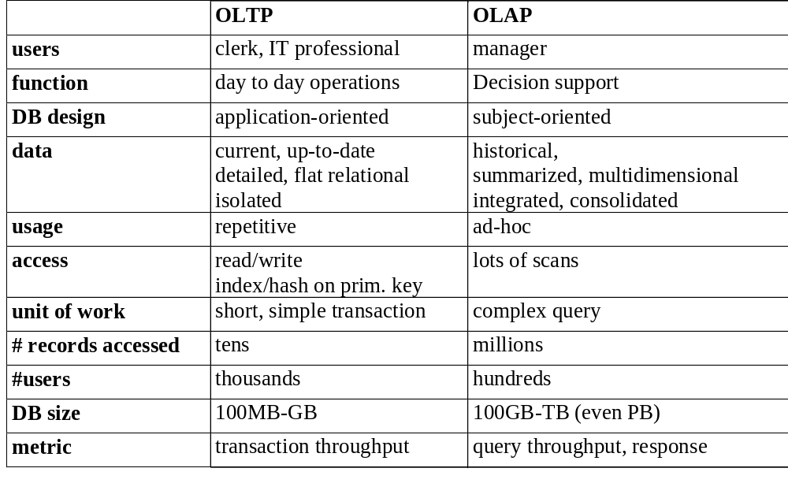
OLTP vs. OLAP

Slide 18
Why Separate Data Warehouse?
High performance for both systems
  DBMS— tuned for OLTP: access methods, indexing, concurrency control, recovery
  Warehouse—tuned for OLAP: complex OLAP queries, multidimensional view, consolidation.
Different functions and different data:
  missing data: Decision support requires historical data which operational DBs do not typically maintain
  data consolidation: DS requires consolidation (aggregation, summarization) of data from heterogeneous sources
  data quality: different sources typically use inconsistent data representations, codes and formats which have to be reconciled

Slide 19
Data Warehousing and OLAP Technology for Data Mining
What is a data warehouse?
A multi-dimensional data model
Data warehouse architecture
Data warehouse implementation
Further development of data cube technology
From data warehousing to data mining

Slide 20
From Tables and Spreadsheets to Data Cubes
A data warehouse is based on a multidimensional data model which views data in the form of a data cube
A data cube, such as sales, allows data to be modeled and viewed in multiple dimensions
  Dimension tables, such as item (item_name, brand, type), or time(day, week, month, quarter, year)
  Fact table contains measures (such as dollars_sold) and keys to each of the related dimension tables

Slide 21
From Tables and Spreadsheets to Data Cubes
A dimension is a perspective with respect to which we analyze the data
A multidimensional data model is usually organized around a central theme (e.g., sales). Numerical measures on this theme are called facts, and they are used to analyze the relationships between the dimensions
Example:
  Central theme: sales
  Dimensions: item, customer, time, location, supplier, etc.

Slide 22
What is a data cube?
The data cube summarizes the measure with respect to a set of n dimensions and provides summarizations for all subsets of them
year
1999
2000
2001
2002
ALL
chairs
25 | 37 | 89 | 21 | 172
10 | 30 | 0 | 45 | 85
56 | 84 | 9 | 35 | 184
19 | 20 | 0 | 71 | 110
5 | 16 | 11 | 15 | 47
115 | 187 | 109 | 187 | 598
tables
product
Data cube
desks
shelves
boards
ALL

Slide 23
What is a data cube?
In data warehousing literature, the most detailed part of the cube is called a base cuboid. The top most 0-D cuboid, which holds the highest-level of summarization, is called the apex cuboid. The lattice of cuboids forms a data cube.
year
base cuboid
1999
2000
2001
2002
ALL
chairs
25 | 37 | 89 | 21 | 172
10 | 30 | 0 | 45 | 85
56 | 84 | 9 | 35 | 184
19 | 20 | 0 | 71 | 110
5 | 16 | 11 | 15 | 47
115 | 187 | 109 | 187 | 598
tables
product
Data cube
desks
shelves
apex cuboid
boards
ALL

Slide 24
Cube: A Lattice of Cuboids
all
0-D(apex) cuboid
time
item
location
supplier
1-D cuboids
time,item
time,location
item,location
location,supplier
2-D cuboids
time,supplier
item,supplier
time,item,location
time,location,supplier
3-D cuboids
time,item,supplier
item,location,supplier
4-D(base) cuboid
time, item, location, supplier

Slide 25
Conceptual Modeling of Data Warehouses
The ER model is used for relational database design. For data warehouse design we need a concise, subject-oriented schema that facilitates data analysis.
Modeling data warehouses: dimensions & measures
  Star schema: A fact table in the middle connected to a set of dimension tables
  Snowflake schema: A refinement of star schema where some dimensional hierarchy is normalized into a set of smaller dimension tables, forming a shape similar to snowflake
  Fact constellations: Multiple fact tables share dimension tables, viewed as a collection of stars, therefore called galaxy schema or fact constellation

Slide 26
Example of Star Schema
time
time_key
day
day_of_the_week
month
quarter
year
item
foreign keys
item_key
item_name
brand
type
supplier_type
Sales Fact Table
time_key
item_key
branch_key
branch
location
location_key
branch_key
branch_name
branch_type
location_key
street
city
province_or_street
country
units_sold
dollars_sold
avg_sales
Measures

Slide 27
Example of Snowflake Schema
time
item
time_key
day
day_of_the_week
month
quarter
year
item_key
item_name
brand
type
supplier_key
supplier
Sales Fact Table
supplier_key
supplier_type
time_key
item_key
branch_key
branch
location
location_key
location_key
street
city_key
branch_key
branch_name
branch_type
units_sold
city
dollars_sold
city_key
city
province_or_street
country
avg_sales
Measures
normalization

Slide 28
Example of Fact Constellation
time
time_key
day
day_of_the_week
month
quarter
year
item
Shipping Fact Table
item_key
item_name
brand
type
supplier_type
Sales Fact Table
time_key
time_key
item_key
shipper_key
item_key
branch_key
from_location
branch
location_key
location
to_location
branch_key
branch_name
branch_type
units_sold
location_key
street
city
province_or_street
country
dollars_cost
dollars_sold
units_shipped
avg_sales
shipper
Measures
shipper_key
shipper_name
location_key
shipper_type

Slide 29
Aggregate Functions on Measures: Three Categories
distributive: if the result derived by applying the function to n aggregate values is the same as that derived by applying the function on all the data without partitioning.
    E.g., count(), sum(), min(), max().
algebraic: if it can be computed by an algebraic function with M arguments (where M is a bounded integer), each of which is obtained by applying a distributive aggregate function.
    E.g., avg(), min_N(), standard_deviation().
holistic: if there is no constant bound on the storage size needed to describe a sub-aggregate.
    E.g., median(), mode(), rank().

Slide 30
Aggregate Functions on Measures: Three Categories (Examples)
Table: Sales(itemid, timeid, quantity)
Target: compute an aggregate on quantity
distributive:
  To compute sum(quantity) we can first compute sum(quantity) for each item and then add these numbers.
algebraic:
  To compute avg(quantity) we can first compute sum(quantity) and count(quantity) and then divide these numbers.
holistic:
  To compute median(quantity) we can use neither median(quantity) for each item nor any combination of distributive functions, too.

Slide 31
Concept Hierarchies
A concept hierarchy is a hierarchy of conceptual relationships for a specific dimension, mapping low-level concepts to high-level concepts
Typically, a multidimensional view of the summarized data has one concept from the hierarchy for each selected dimension
Example:
  General concept: Analyze the total sales with respect to item, location, and time
  View 1: <itemid, city, month>
  View 2: <item_type, country, week>
  View 3: <item_color, state, year>
  ....

Slide 32
A Concept Hierarchy: Dimension (location)
all
all
region
Europe
...
North_America
country
Germany
...
Spain
Canada
...
Mexico
city
Frankfurt
...
Vancouver
...
Toronto
office
L. Chan
...
M. Wind

Slide 33


View of Warehouses and Hierarchies
Specification of hierarchies
Schema hierarchy
  day < {month < quarter; week} < year
Set_grouping hierarchy
  {1..10} < inexpensive

Slide 34
Multidimensional Data
Sales volume as a function of product, month, and region
Dimensions: Product, Location, Time
Hierarchical summarization paths
Region
Industry Region Year
Category Country Quarter
Product City Month Week
Office Day
Product
total order
Month
partial order
(lattice)

Slide 35

A Sample Data Cube
Date
Total annual sales
of TV in U.S.A.
1Qtr
2Qtr
3Qtr
4Qtr
sum
Product
TV
PC
U.S.A
VCR
sum
Canada
Country
Mexico
sum
All, All, All

Slide 36
Cuboids Corresponding to the Cube
all
0-D(apex) cuboid
product
date
country
1-D cuboids
product,date
product,country
date, country
2-D cuboids
3-D(base) cuboid
product, date, country
The cuboids are also called multidimensional views

Slide 37
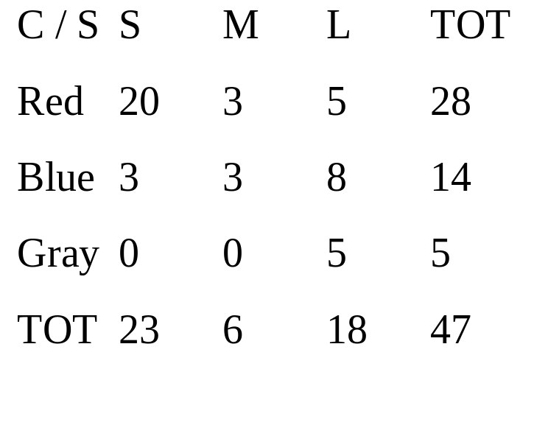
DataCube example
‘color’, ‘size’: DIMENSIONS
‘count’: MEASURE
φ
size
color
color; size

Slide 38
DataCubes
‘color’, ‘size’: DIMENSIONS
‘count’: MEASURE
φ
size
color
color; size

Slide 39
DataCubes
‘color’, ‘size’: DIMENSIONS
‘count’: MEASURE
φ
size
color
color; size

Slide 40
DataCubes
‘color’, ‘size’: DIMENSIONS
‘count’: MEASURE
φ
size
color
color; size

Slide 41
DataCubes
‘color’, ‘size’: DIMENSIONS
‘count’: MEASURE
φ
size
color
color; size

Slide 42
DataCubes
‘color’, ‘size’: DIMENSIONS
‘count’: MEASURE
φ
size
color
color; size
DataCube

Slide 43

Browsing a Data Cube
Visualization
OLAP capabilities
Interactive manipulation

Slide 44
Typical OLAP Operations
Browsing between cuboids
  Roll up (drill-up): summarize data
    by climbing up hierarchy or by reducing a dimension
  Drill down (roll down): reverse of roll-up
    from higher level summary to lower level summary or detailed data, or introducing new dimensions
Slice and dice:
  project and select
Pivot (rotate):
  reorient the cube, visualization, 3D to series of 2D planes.
Other operations
  drill across: involving (across) more than one fact table
  drill through: through the bottom level of the cube to its back-end relational tables (using SQL)

Slide 45
Example of operations on a Datacube
φ
size
color
color; size

Slide 46
Example of operations on a Datacube
Roll-up:
  In this example we reduce one dimension
  It is possible to climb up one hierarchy
    Example (product, city) → (product, country)
φ
size
color
color; size

Slide 47
Example of operations on a Datacube
Drill-down
  In this example we add one dimension
  It is possible to climb down one hierarchy
    Example (product, year) → (product, month)
φ
size
color
color; size

Slide 48
Example of operations on a Datacube
Slice: Perform a selection on one dimension
φ
size
color
color; size

Slide 49
Example of operations on a Datacube
Dice: Perform a selection on two or more dimensions
φ
size
color
color; size

Slide 50
Design of a Data Warehouse: A Business Analysis Framework
Four views regarding the design of a data warehouse
  Top-down view
    allows selection of the relevant information necessary for the data warehouse
  Data source view
    exposes the information being captured, stored, and managed by operational systems
  Data warehouse view
    consists of fact tables and dimension tables
  Business query view
    sees the perspectives of data in the warehouse from the view of end-user

Slide 51
Data Warehouse Design Process
Top-down, bottom-up approaches or a combination of both
  Top-down: Starts with overall design and planning
  Bottom-up: Starts with experiments and prototypes (rapid)
From software engineering point of view
  Waterfall: structured and systematic analysis at each step before proceeding to the next
  Spiral: rapid generation of increasingly functional systems, short turn around time, quick turn around
Typical data warehouse design process
  Choose a business process to model, e.g., orders, invoices, etc.
  Choose the grain (atomic level of data) of the business process
  Choose the dimensions that will apply to each fact table record
  Choose the measure that will populate each fact table record

Slide 52
Multi-Tiered Architecture
Monitor
&
Integrator
OLAP Server
other
sources
Metadata
Analysis
Query
Reports
Data mining
Operational
DBs
Extract
Transform
Load
Refresh
Data
Warehouse
Serve
Data Marts
Data Sources
Data Storage
OLAP Engine
Front-End Tools

Slide 53
Three Data Warehouse Models
Enterprise warehouse
  collects all of the information about subjects spanning the entire organization
Data Mart
  a subset of corporate-wide data that is of value to a specific groups of users. Its scope is confined to specific, selected groups, such as marketing data mart
    Independent vs. dependent (directly from warehouse) data mart
Virtual warehouse
  A set of views over operational databases
  Only some of the possible summary views may be materialized

Slide 54
Data Warehouse Development: A Recommended Approach
Multi-Tier Data Warehouse
Distributed Data Marts
Enterprise Data Warehouse
Data Mart
Data Mart
Model refinement
Model refinement
Define a high-level corporate data model

